Slide 1
Introduction to z/OS Security
Lesson 5: SAF and RACF
Jacky.marcisz@fr.ibm.com

Slide 2
Objectives
At the completion of this topic the student should understand
  how SAF and RACF combine to support the CIA model of security
  the interaction between z/OS resource managers and SAF/RACF
  the methods to manage RACF options

Slide 3
Key Terms
SAF
SAF router
ESM
System Monitoring Facility
Classes, Profiles, and ACLs
IFASMFDP
SMF record
Security category
Security level
Security label
Mandatory Access Control
Identity
Authentication
Authorization Checking
Access types
Security Context
Access Levels
POSIT Values
RACROUTE

Slide 4
Overview
Addressing Security concerns with z/OS
  Confidentiality: Z.OS protects the confidentiality of your data through the use of a central security control point and external security managers
  Integrity: z/OS supports the use of digital certificates. Messages sent from z/OS can be signed by the sender to assure authenticity of both the sender and the data.
  Availability: z/OS is designed to be available at all times. Error recover processing is standard on system components. As long as you are able to get onto the z.OS system, your data is accessible to you.

Slide 5
Introduction
Addressing Security concerns with z/OS
  Confidentiality: z/OS protects the confidentiality of your data through the use of a central security control point and external security managers
    Allowing only permitted users to access resources provides the confidentiality of the data required.
  Integrity: z/OS supports the use of digital certificates. Messages sent from z/OS can be signed by the sender to assure authenticity of both the sender and the data.
    users are expected to protect their passwords. A user accessing the system with a password is implementing a shared secret between z/OS and the user. It is assumed that if the password is used then it is the assigned person using it.
  Availability: z/OS is designed to be available at all times. Error recover processing is standard on system components. As long as you are able to log onto the z.OS system, your data is accessible to you. The security components will not prevent a permitted user from accessing resources.

Slide 6
SAF
SAF is NOT part of RACF
SAF is a component of MVS (z/OS BCP)
SAF is the System Access Facility element of z/OS. Its purpose is to provide the interface between those products requesting security services and the external security manager installed on the z/OS system.
SAF provides an installation with centralized control over system security processing by using a system service called the SAF router. The SAF router provides a focal point and a common system interface for all products providing resource control.
External security managers (ESMs) provide tables to SAF, which directs specific calls for security functions to specific routines within the ESM. The use of these tables allows z/OS to provide support for pluggable ESMs giving the installation the flexibility to determine which ESM to use..
SAF and the SAF router are present on all z/OS systems regardless of whether an ESM is installed.

Slide 7

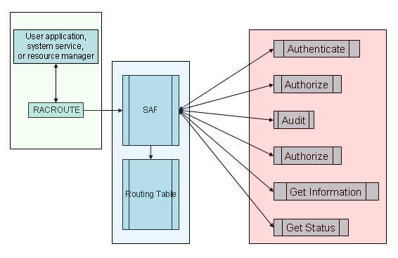
The SAF Router
For each request type presented to SAF, a
different routine is
accessed.
The location of these
routines are in the SAF Routing Table

Slide 8
RACF
RACF is the Resource Access Control Facility. It is NOT an entitlement of the z/OS operating system, but is a priced feature. Customers pay extra for RACF.
RACF provides the capability to uniquely describe resources, users, and the relationships between them.
When users attempt to access a resource the system calls RACF to indicate whether or not that user has the requested access permissions.
It is then the system's decision, not RACF's, to allow or deny the access request.

Slide 9
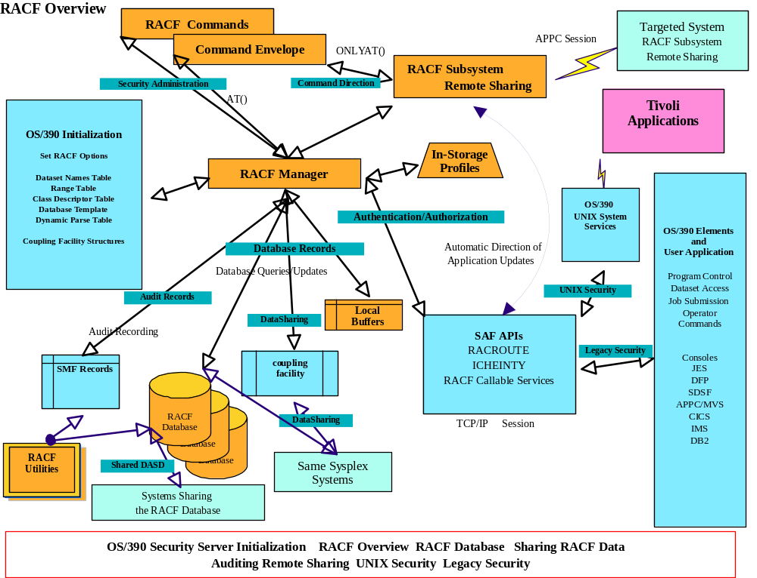
RACF Overview

Slide 10
Managing Authentication
Users must authenticate to the system in order to exploit resources
System users are required to present evidence that their identity is authentic. On z/OS, the typical credentials used are a user ID and a password.
A user presents the user ID and password to a resource manager such as TSO/E or USS through a series of questions and replies.
The resource manager passes the credentials on to the security manager, such as RACF, to be verified.
Upon verification, the security manager passes a security context back to the resource manager, or associates the security context with either the current address space or task, depending on the request type.
At this point the user is deemed authentic and may proceed to use the system resources to which he is authorized.

Slide 11
The Security Context
A security context is the representation of an authenticated user identity within the system.
In z/OS the security context is the ACEE control block.
  Connected to the user’s address space via ASCBASXB->ASXBSENV->ACEE
  Connected to tasks via TCBSENV->ACEE
The ACEE contains the user’s basic information:
  User ID
  Name
  Group list
  Current connect group
  Attributes
    SPECIAL, OPERATOR, AUDITOR, PROTECTED, REVOKED, RESUME DATE
An ACEE is created when a process is started: LOGON, MOUNT, or START, or whenever an application issues either RACROUTE REQUEST=VERIFY, ENVIR=CREATE or InitACEE (for USS)
The security context is carried throughout the entire session to which a user is logged on

Slide 12
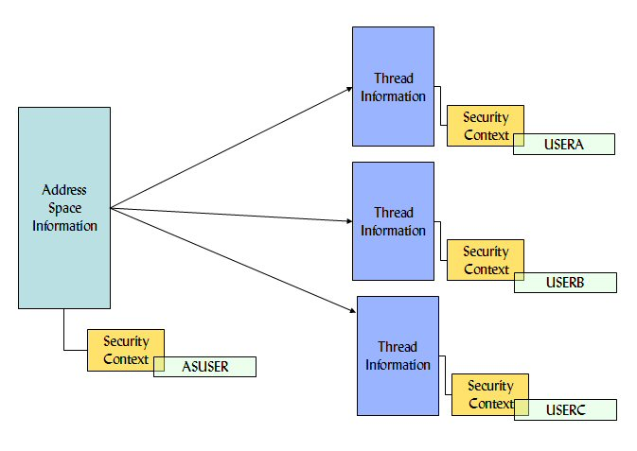
Multiple Security Contexts
Address spaces may have multiple tasks, each with their own security context as shown.
A daemon, for example, may start tasks for each client that requests its services.
Each task could then run with the less privileged identity of the requesting client identity, while the daemon executes with higher privileges.

Slide 13
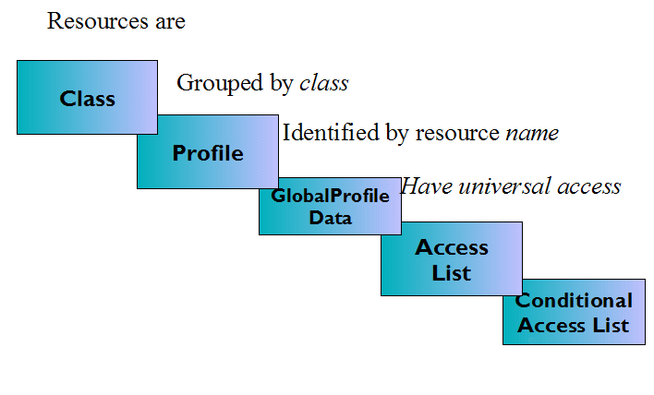
Security profile hierarchy

Slide 14
Resource, user, and group profiles
A resource is any item on the system that may be exploited by a user.
A user is an exploiter of resources
A protection profile describes the resource
A user profile uniquely describes a user to the system
Users can be grouped together
Resource protection profiles are grouped together by Class
Access to resources can be provided to the group

Slide 15
Access lists
Access control lists (ACLs) denote the user or group name and the level of access they are allowed.
Conditional access lists have additional restrictions on the access
For example: You can require that
  a user be logged onto a particular terminal
  a user be logged onto a particular console
  the batch job accessing the resource to have been submitted from a particular JES input device
  a user enter the system from a particular partner APPC LU
  a user enter the system from an IP address contained in a particular network access security zone
  user enter the system from an IP address contained in a particular network access security zone only when executing a particular program

Slide 16
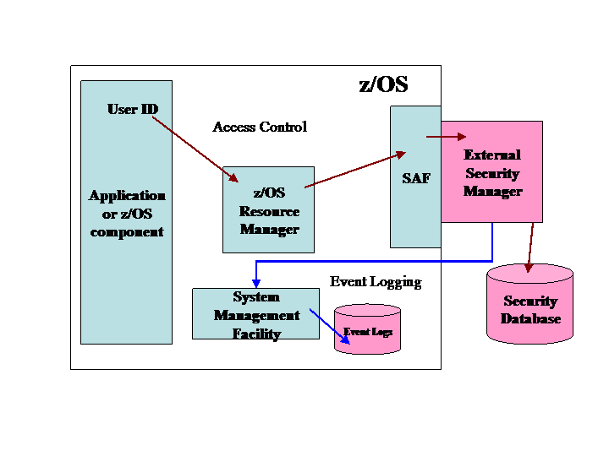
Mechanics of Authorization Checking
A user ID is passed from the application or system component to the resource manager. The resource manager maintains the data that the user wishes to access. The resource manager may provide its own security, but is more likely to call SAF to perform an authorization check.
SAF passes the user ID, resource requested, and access type to the external security manager.
The external security manager (ESM) refers to its database in order to make a decision. Additionally, the eternal security manager may request that an event log record be created by the System Management Facility (SMF).
Information is passed by the ESM back to SAF and ultimately to the resource manager. The resource manager makes the decision to allow or deny access based on the security information it now has.

Slide 17
Authorization checking with
RACROUTE REQUEST=AUTH
Resource managers attempting to perform authorization checking on behalf of a user must provide the name of the resource and the class in which it is described.
An example of an authorization check:
DCL WAREA CHAR(512); ! Declare a work area for racroute
DCL ENTNAME CHAR(44); ! This is the location of the profile name
DCL TEMPACEE PTR(31); ! And the location of the pointer to a security context
Entname = ‘thename.ofa.profile’; ! Fill in the profile name
Gen code(entname, tempacee, warea); ! Oh yeah, RACROUTE is an assembler macro
L1 RACROUTE REQUEST=AUTH,
        CLASS=‘FACILITY’,
        ENTITY=ENTNAME,
        ATTR=READ,
        ACEE=TEMPACEE,
        WORKA=WAREA,
        RELEASE=2.2,
        MF=(E,D1)
@endgen;
*Note that TEMPACEE needs to contain the pointer to an ACEE previously obtained via RACROUTE REQUEST=VERIFY,ENVIR=CREATE

Slide 18
RACF Options
Using SETROPTS
RACF provides the SETROPTS (Set RACF Options - SETR) command to manage the global RACF environment.
SETROPTS is used to
  manage classes
    Activate and deactivate
    RACLIST and un-RACLIST
    Logging
    Generic capabilities
  Manage MLS
    Write down
    MLS in USS
    MLS in CS390
  Program control
  Password processing options
  Language options

Slide 19
RACF Class definitions
RACF provides predefined classes through the installation of the ICHRRCDX module (when RACF is installed)
Additional classes may be installation defined through ICHRRCDE
Additional classes may be installation defined through the CDT Class
Most classes have different posit values.
  The POSIT number identifies a set of option flags that controls RACF processing options
  If you choose to use a unique set of option flags for a class, assign the class a unique POSIT number. If you choose to share the same set of option flags among several classes, assign those classes the same POSIT number.
    For example: All the CICS related classes share the same posit value

Slide 20
Posit Options
RACF processing options based on POSIT:
  Whether authorization checking should take place for the class
    SETROPTS CLASSACT(class name list)
  Whether auditing should take place for resources within the class
    SETROPTS AUDIT(class name list)
  Whether statistics should be kept for resources within the class
    SETROPTS STATISTICS(class name list)
  Whether generic profile access checking is active for the class
    SETROPTS GENERIC(class name list)
  Whether generic command processing is active for the class
    SETROPTS GENCMD(class name list)
  Whether global access checking is active for the class
    SETROPTS GLOBAL(class name list)
  Whether user has CLAUTH to a resource class
  Whether special resource access auditing applies to the class
    SETROPTS LOGOPTIONS(Restriction(class name list))
  Whether SETROPTS RACLIST will occur for this class
    SETROPTS RACLIST(class name list) <REFRESH>

Slide 21
Mechanics of z/OS Security
A user ID is passed from the application or system component to the resource manager. The resource manager maintains the data that the user wishes to access. The resource manager may provide its own security, but is more likely to call SAF to perform an authorization check.
SAF passes the user ID, resource requested, and access type to the external security manager.
The external security manager (ESM) refers to its database in order to make a decision. Additionally, the eternal security manager may request that an event log record be created by the System Management Facility (SMF).
Information is passed by the ESM back to SAF and ultimately to the resource manager. The resource manager makes the decision to allow or deny access based on the security information it now has.

Slide 22
Protecting resources on z/OS
Address space and task security
  User ID is contained in a security context.
  Address spaces have multiple tasks, each with their own security context.
  The context can be associated either at the address space level or the task level

Slide 23
Security Context
Security contexts
  When an authentication request is made to z/OS a call to SAF occurs.
  When a process attempts to access a resource such as a file, printer, or system service, the access control list of the resource is check by the ESM.
  The ability of a program running under one identity to check the authority of another identity to a resource is called third party authorization.

Slide 24
Multiple Security Contexts
Address spaces have multiple tasks, each with their own security context as shown.
A daemon, for example, may start tasks for each client that requests its services.
Each task could then run with the less privileged identity of the requesting client identity, while the daemon executes with higher privileges.

Slide 25
The Security Authorization Facility (SAF)
Requests for security services on z/OS are passed through the Security Authorization Facility (SAF). This facility is the interface between system services and the External Security Manager (ESM) installed on the system.
SAF routes requests for authentication, resource accesses checking, and other security related processes to the ESM through control points.
Applications and system components call these common control points in order to interface with the ESM. Security on z/OS is therefore centralized on SAF and the installed ESM.
When there is no ESM installed, SAF creates the security constructs needed by system services.

Slide 26

The SAF Router
SAF is accessed through the RACROUTE macro.
RACROUTE provides the services to authenticate a user ID, interrogate access permissions, perform security event logging, and obtain a security context for address spaces and tasks running on the system.
Regardless of the ESM installed, applications and system services use RACROUTE.
The application does not need to know which ESM is installed, or indeed if one is present at all.
The SAF router uses the routing table to associate the correct ESM programs with the related RACROUTE call

Slide 27

External Security Managers (ESMs)
Makes the distinction between the resources to be protected and the entities which would like to access them.
Provides the capability to uniquely
describe resources and users.
Some z/OS components require that
an ESM be installed.
  Important: Applications which use TCP/IP protocols, such as a web server, FTP, telnet, LDAP, and NFS are unavailable unless an ESM is installed.
Notes:
Additional security interfaces
There are many system components that provide APIs into z/OS. Without listing
all the callable services, macros, and commands, let’s look at the general areas
where security related interfaces are available:
SAF
as discussed in “The Security Authorization Facility”
on page 7-118, SAF is the router between system
services and applications, and the external security
manager. SAF also provides functions and exit points
which are used by z/OS installations to manage security.
Access SAF via RACROUTE
The ESM
as discussed in “External security managers” on
page 7-124, it is the installed security manager which
provides the majority of the security functions on z/OS.
Access the ESM through SAF via RACROUTE.
Additionally, the ESM may provide non-SAF APIs.
Hardware crypto
on z/OS it is the Integrated Cryptographic Services
Facility (ICSF) component which manages access to the
cryptographic hardware of the System z. ICSF provides
interfaces for data conversion, key generation, public key
manipulation, and digital signature verification. Refer to
Section 4.6, “Encryption - A Must today” on page 4-87 for
more information on hardware cryptography on System z.
Software crypto
z/OS provides the SSL and OCSF components for
_x0001_ __check_resource_auth_np() -- Determine Access to MVS Resources
_x0001_ __convert_id_np() -- Convert Between DCE UUID and user ID
_x0001_ __login() -- Create a New Security Environment for Process
_x0001_ __certificate() -- Register/Deregister/Authenticate a Digital Certificate
_x0001_ __passwd() -- Verify or change a user’s password
_x0001_ chaudit() -- Change Audit Flags for a File by Path
_x0001_ chlabel() -- Add a SECLABEL to a file or directory
_x0001_ chown() -- Change the owner of a file or directory
_x0001_ getlogin() -- Get the user login name
_x0001_ pthread_security_np() -- Create or Delete Thread-level Security
6776ch07 SAF & RACF Craig.fm Draft Document for Review July 21, 2005 2:10 pm
124 z/OS Basics
software cryptography. Refer to Section 9.2.1, “Network
Security” on page 9-187 for more information on SSL.
Unix System Services
the POSIX implementation on z/OS provides a set of
commands, such as chmod, chown, and chlabel, to
manage file system security. Refer to Chapter 8, “z/OS
UNIX security” for a discussion on Unix security on z/OS.

Slide 28
Available Security Managers
There are several security managers available for z/OS.
The most popular ones are:
  Security Server for z/OS Resource Access Control Facility (RACF) from IBM®
  eTrust CA-ACF2® Security for z/OS from Computer Associates®
  eTrust CA-Top Secret® Security for z/OS from Computer Associates®
Examples within this text use the perspective of IBM’s RACF to illustrate concepts.

Slide 29
ESM
Permission Control
  Main function of the ESM is to maintain access control lists for resources.
  Requesting access to resources

Slide 30
Access levels
  None -No access is granted to the specified resource
  Execute - allows users and groups to execute programs from the library, but they cannot read or write to the library.
  Read - the lowest level of permission to a resource. This allows users and groups to access the resource but not to alter its contents
  Update - allows users and groups to change the contents of resource. The user is not authorized to delete the resource.
  Alter - allows users and groups full control over the resource
  Control - grants users and groups authority to VSAM datasets that equivalent to the VSAM control password.

Slide 31
Conditional Access
  Special type of permission that is dependent upon from where the user has accessed the system.
  The information that is sent to SAF when an authorization check is made may contain the user’s port of entry (POE), such as a terminal or location in the network.
  The conditional access list states what level of permission the user can successfully request when accessing the resource from that POE.
  Conditional access allows the installation to only authorize access from a specific set of terminals.
  For example: Users may be allowed to access the resource if they are using a terminal that is in a locked room, but not from a terminal in a public area.

Slide 32
Mandatory Access Control
  Mandatory access control uses security labels which determine the sensitivity of the resource. Systems which implement MAC are said to be multi-level secure.
  Characteristics of a multilevel-secure system include the following:
    The system controls access to resources.
    The system does not allow a storage object to be reused until it is purged of residual data.
    The system enforces accountability by requiring each user to be identified, and creating audit records that associate security-relevant events with the users who cause them.
    The system labels all hardcopy with security information.
    The system optionally hides the names of data sets, files and directories from users who do not have access to those data objects.
    The system does not allow a user to declassify data by “writing down" except with explicit authorization to do so.

Slide 33
Mechanics of MAC
  Uses security labels which determine the sensitivity of the resources.
  Security levels
    The hierarchical security level defines the degree of sensitivity of the data.
    SECLEVELs have a name and a value assigned.
  Security Categories
    The non-hierarchical categories further qualify the access capability.
    The security administrator can define zero or more categories that correspond to some grouping arrangement in the installation.
  SECLABELS
    A security label establishes an association between a RACF security level and a set of zero or more RACF security categories.

Slide 34
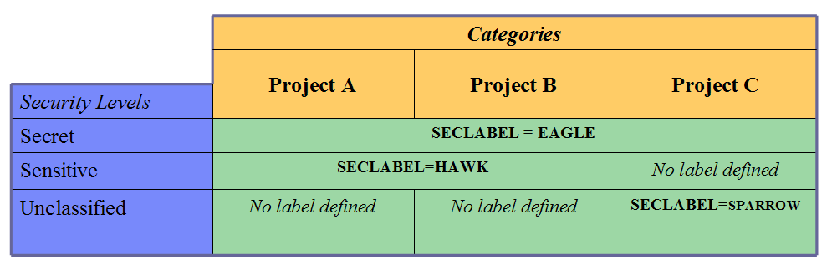
Mechanics of MAC
A system might have three security levels, unclassified, sensitive, and secret, and three security categories, Project A, Project B, and Project C.
EAGLE could be a security label name indicating Secret for Project A, Project B, and Project C.
HAWK could be a security label name meaning Sensitive for Project A and Project B;
SPARROW could be a security label name indicating unclassified for Project C.

Slide 35
Summary
SAF and RACF work together to provide security functions on z/OS
Users authenticate their identity credentials to the system to obtain a security context
The security context is used during access checking to verify authorization to resources
Resources are grouped together by Class
Classes are defined by both IBM and the customer
Classes are managed through RACF commands
There are various types of security events in the environment.
Mandatory access control provides the ability to section off resources on your system.
Security event logging is under the control of the external security manager

